Slide 1
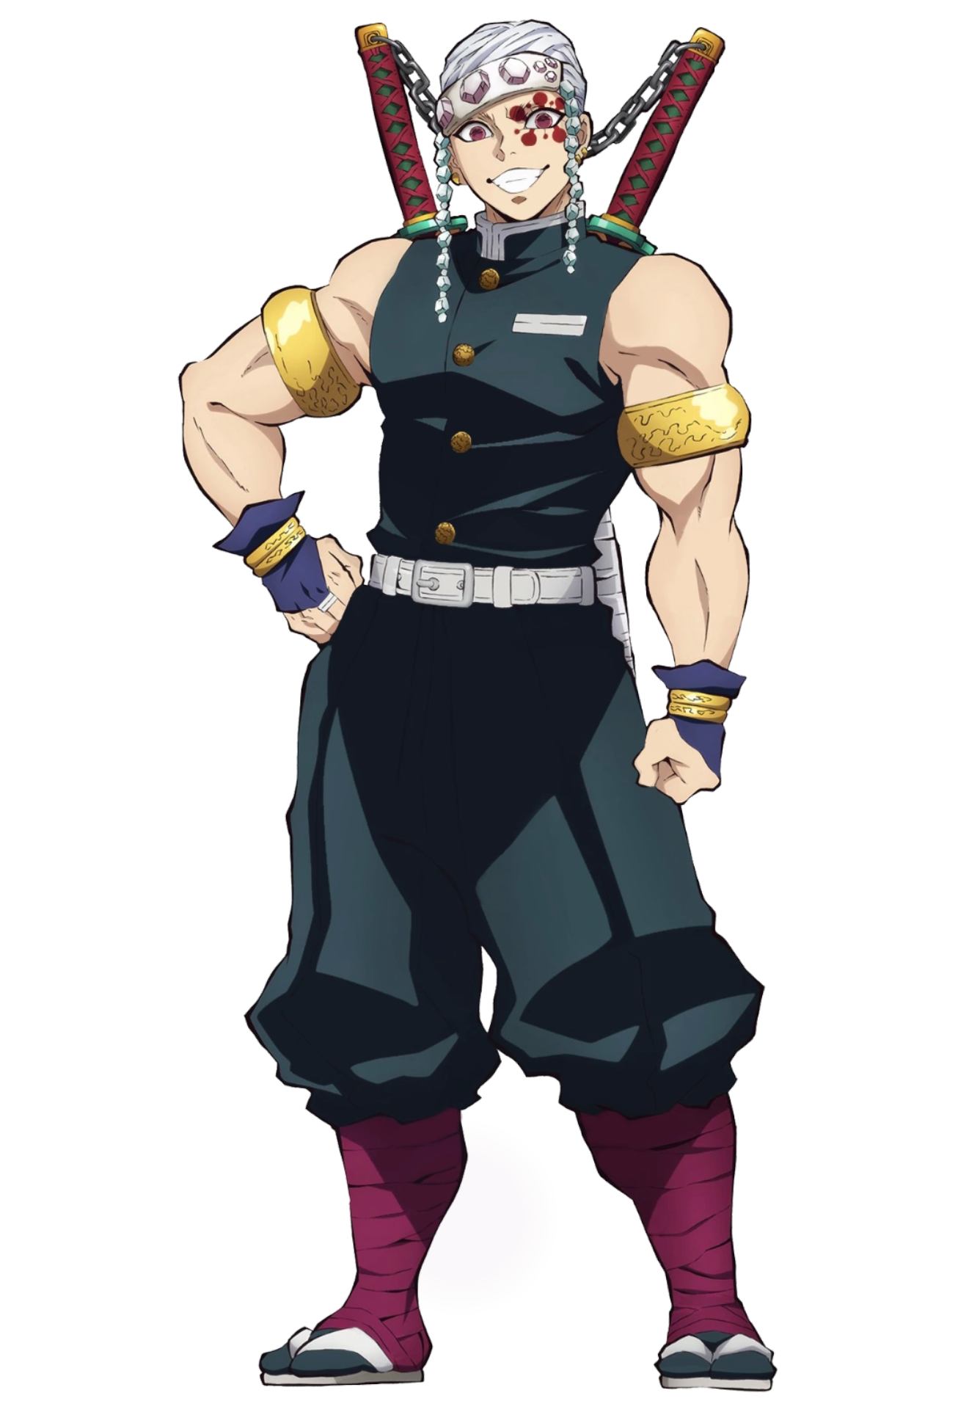
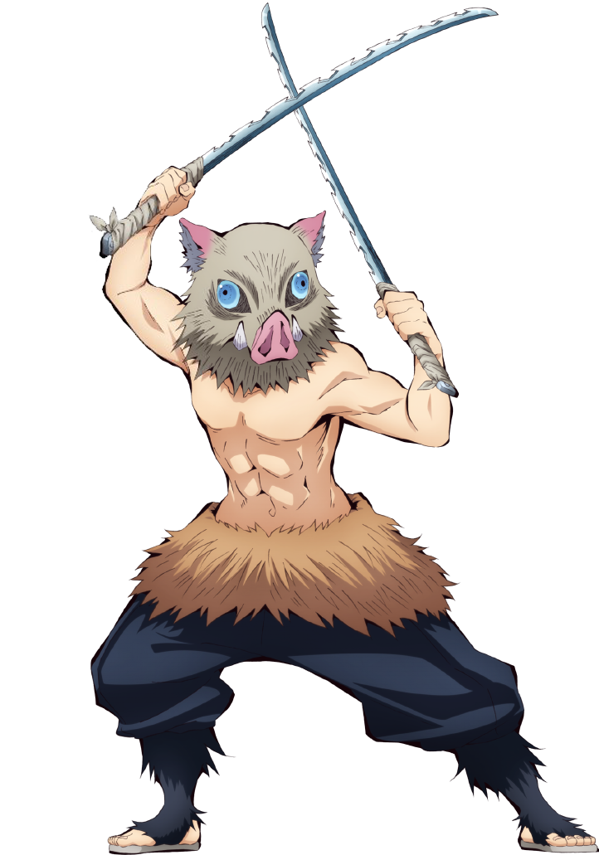
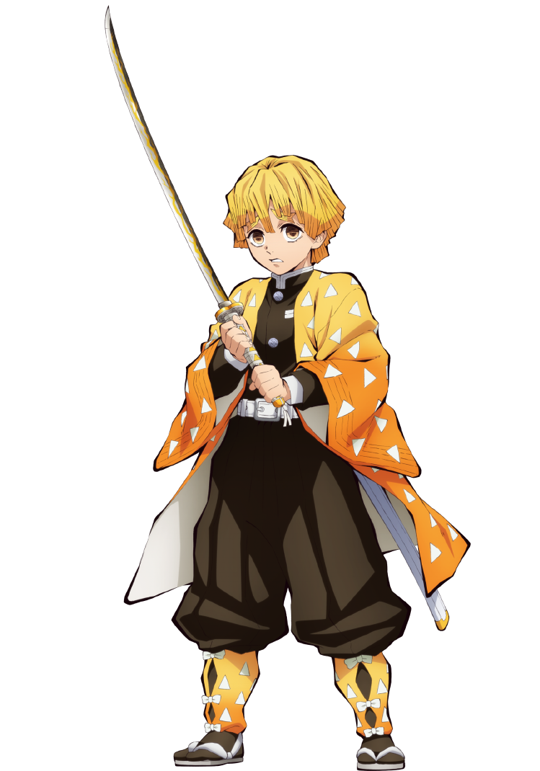
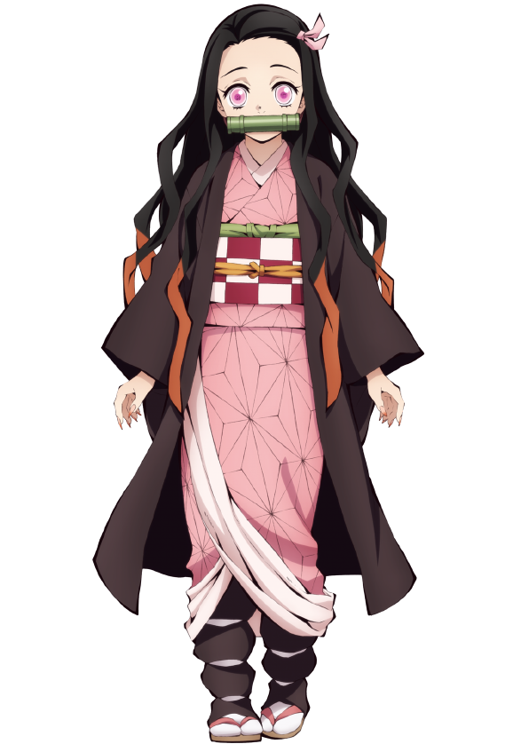
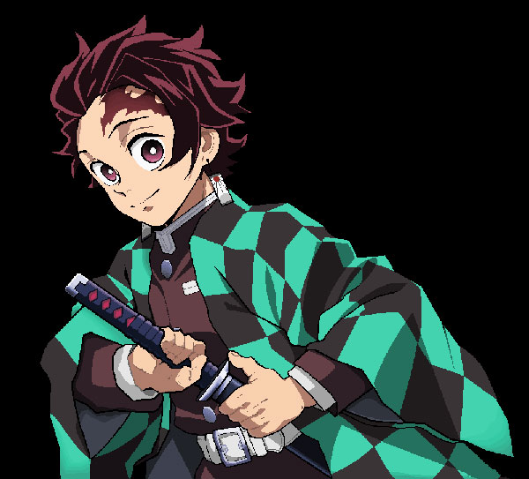

Student ID: hkong44
Noobies, are you ready for the fight? Do not slow me down.
I do not have time to save you!
Wait! I am not a demon!
I use the boar headgear to hide my handsome face.
I grew up in the mountains with an unusual "sense of touch" and can sense the shaking of the air.
I created my own I-ryu - Breath of the Beast without the guidance of a trainer.
Move!Move!
Beast Breathing! My name is Hashibira Inosuke.
I become demon since I got bet by a demon. But I still can recognize my brother.
I thirst for blood but I wont hurt my brother.
My name is Nezuko.
After my family got killed by demon,
I joined the Demon Killing Squad to protect my sister Nezuko and
slay demon.
Water Breathing! My name is Tanjiro.
Thunder Breathing! My name is Agatsuma Zenitsu.
If I am under excessive tension and fear, I will fall into a deep sleep state
and display my superb swordsmanship Thunder Breathing Method in a sleeping position,
but I do not know this. Although at present, only one of the six basic types
of Thunder Breathing Method has been learned.

